Slide 1

SRM INSTITUTE OF SCIENCE AND TECHNOLOGY
SCHOOL OF COMPUTING
DEPARTMENT OF COMPUTING TECHNOLOGIES
18CSP109L / 18CSP111L - MAJOR PROJECT / INTERNSHIP
STUDENT ENGAGEMENT MEASUREMENT IN E-LEARNING SYSTEMS
BATCH NO : NWC027028
TEAM :
Om Rajput (RA1911032010028)
Suyash Nigam (RA1911032010027)
Project Guide :
Dr. TVJ Naga Malleswari

Slide 2
Table of Contents
Project Title and Abstract
Literature Review
Comparison of Existing methods with merits and demerits
Challenges To Address
Problem Statement and Objectives
Architecture diagrams of modules
UML diagrams / ER diagrams/Use case diagram/Activity diagram
Modules Description and Implementation (50%)
Algorithms used
Intermediate Results and Discussion

Slide 3
Objectives of the Project
The task is to implement an online meeting application with a student interactivity measurement feature.
The objectives of this project include -
A meeting platform for students as well as business professionals.
Participant interactivity measurement for the host.
Detailed focus analysis dashboard for the host.

Slide 4
Literature Review
S/No | Paper Title | Author | Year | Journal | Ranking Criterion
 |  |  |  |  | Broad Domain | Existing Systems Addressed | Drawback/Flaws | Problem Addressed | Algorithms/ Tools/ Techniques Used
1 | A survey on: Facial Emotion Recognition and Classification | Manoj Moolchandani; Shivangi Dwivedi; Samarth Nigam; Kapil Gupta | 2021 | IEEE | Image classification | Emotion Detection using computer vision | Misclassified disgust and neutral mood | Face Localization Feature Extraction | CNN
2 | An Integrated Vision System on Emotion Understanding and Identity Confirmation | Yang-Yen Ou; An-Chao Tsai; Jhing-Fa Wang; Po-Chien Lin | 2018 | IEEE | Computer Vision | Emotion Detection using computer vision | Required data for training and subsequent identification is too complicated. | Person identification by posture and facial identifiers. | CNN

Slide 5
S/No | Paper Title | Author | Year | Journal | Ranking Criterion
 |  |  |  |  | Broad Domain | Existing Systems Addressed | Drawback/Flaws | Problem Addressed | Algorithms/ Tools/ Techniques Used
3 | Computer Vision for Attendance and Emotion Analysis in School Settings | Sarah Deniz; Dakyung Lee; Grace Kurian; Lourdes Altamirano; Darren Yee | 2019 | IEEE | Computer Vision | Emotion Detection using computer vision | Requires perfectly aligned cameras for proper data capture. | Can do face detection, face recognition, and emotion analysis | CNN
4 | Neutral Face Classification Using Personalized Appearance Models for Fast and Robust Emotion Detection | Pojala Chiranjeevi; Viswanath Gopalakrishnan; Pratibha Moogi | 2015 | IEEE | Computer Vision | Emotion Detection using computer vision | Required data for training and subsequent identification is too complicated. | Reduced model size to work on mobile devices and tablets. | CNN

Slide 6
Comparison of Existing methods with merits and demerits
Research Paper | Merit | Demerit
A survey on: Facial Emotion Recognition and Classification | Face Localization Feature Extraction | Misclassified disgust and neutral mood
An Integrated Vision System on Emotion Understanding and Identity Confirmation | Person identification by posture and facial identifiers. | Required data for training and subsequent identification is too complicated.
Computer Vision for Attendance and Emotion Analysis in School Settings | Can do face detection, face recognition, and emotion analysis | Requires perfectly aligned cameras for proper data capture.
Neutral Face Classification Using Personalized Appearance Models for Fast and Robust Emotion Detection | Reduced model size to work on mobile devices and tablets. | Required data for training and subsequent identification is too complicated.

Slide 7
Challenges To Address
Due to low Bandwidth issues :
The video is not visible
voice breakage
Infrastructure Issues : The need for a computer, adequate software, constant electricity and high-bandwidth internet is quite a big demand.
Electricity :Many parts of India still have low electricity supply

Slide 8
Problem Statement and Objectives
The task is to implement an online meeting application with a student interactivity measurement feature.
The objectives of this project include -
A meeting platform for students as well as business professionals.
Participant interactivity measurement for the host.
Detailed focus analysis dashboard for the host.

Slide 9
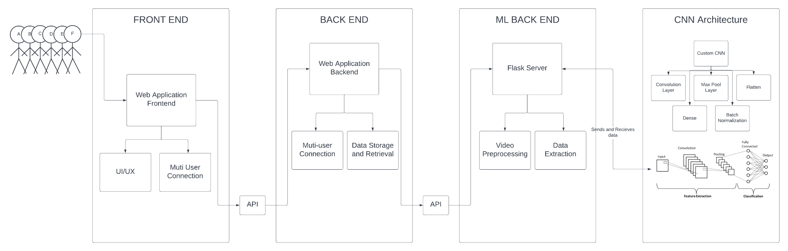
Architecture diagram of modules

Slide 10
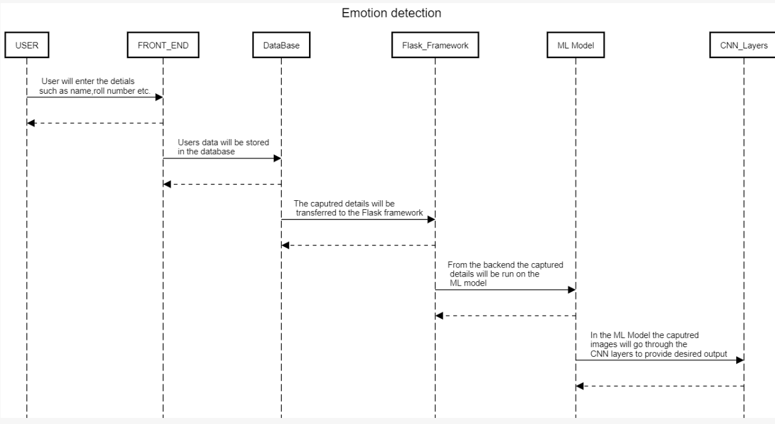
Sequence Diagram

Slide 11
Algorithms used
CNN (Convolution Neural Network) - used for Image processing and emotion detection
Using Feature Extraction, to transform raw pixels to numerical features.

Slide 12
Intermediate Results and Discussion
We have so far managed to create a plan of action to implement the idea of integrating an online meeting application with a deep learning model to detect facial expressions.
Work on a research paper has also been started which has been proposed as more of a comparative study.

Slide 13
Thank You

